Slide 1

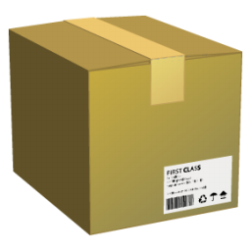
Asset Management

Slide 2
Agenda
Asset Management Basics
Create Assets
Product Category
Allow Asset Management
Identifier Label
Asset Statuses
Asset Meta Fields
Product
Asset
Asset Groups
Transitions
Upload Assets
Add Assets to Orders
Create Assets on the Fly

Slide 3
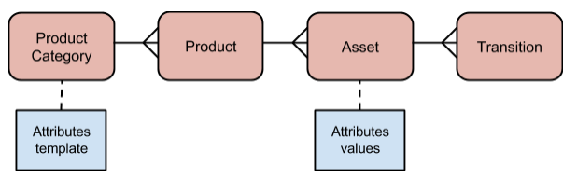
Asset Management Basics
What is it?
Manage inventory of unique physical goods.

Slide 4
Agenda
Asset Management Basics
Create Assets
Product Category
Allow Asset Management
Identifier Label
Asset Statuses
Asset Meta Fields
Product
Asset
Asset Groups
Transitions
Upload Assets
Add Assets to Orders
Create Assets on the Fly

Slide 5
Create Assets – Product Category
Allow Asset Management
We have the possibility to mark a category to Allow Asset Management or not. This is to maintain backward compatibility with previous functionalities.

Slide 6
Agenda
Asset Management Basics
Create Assets
Product Category
Allow Asset Management
Identifier Label
Asset Statuses
Asset Meta Fields
Product
Asset
Asset Groups
Transitions
Upload Assets
Add Assets to Orders
Create Assets on the Fly

Slide 7

Create Assets – Product Category
Identifier Label
We can change the Label for the identifier field.
This doesn’t change anything at the DB level.
It’s just the label used in the UI.

Slide 8
Agenda
Asset Management Basics
Create Assets
Product Category
Allow Asset Management
Identifier Label
Asset Statuses
Asset Meta Fields
Product
Asset
Asset Groups
Transitions
Upload Assets
Add Assets to Orders
Create Assets on the Fly

Slide 9
Create Assets – Product Category
Statuses
Statuses are mandatory.
We have 3 pre-defined types:
AVAILABLE (Asset is available for selling)
DEFAULT (Status used upon creation, when the order is cancelled or the asset is removed)
ORDERED (Used when the asset is added to an order)
RESERVED (TBD)

Slide 10
Agenda
Asset Management Basics
Create Assets
Product Category
Allow Asset Management
Identifier Label
Asset Statuses
Asset Meta Fields
Product
Asset
Asset Groups
Transitions
Upload Assets
Add Assets to Orders
Create Assets on the Fly

Slide 11
Create Assets – Product Category
Meta Fields
We can define meta fields that will be available for any asset created under the parent category.

Slide 12
Create Assets – Product Category
Steps
Mark the Product Category to Allow Asset Management.
Define 1 Default and 1 Ordered Status.
Define at least 1 Available Status.
If needed, define Meta Fields.
Show Example

Slide 13
Agenda
Asset Management Basics
Create Assets
Product Category
Allow Asset Management
Identifier Label
Asset Statuses
Asset Meta Fields
Product
Asset
Asset Groups
Transitions
Upload Assets
Add Assets to Orders
Create Assets on the Fly

Slide 14
Create Assets – Product
Inside an Asset Management Product Category we can have Products with and without Assets.
Show Example

Slide 15
Agenda
Asset Management Basics
Create Assets
Product Category
Allow Asset Management
Identifier Label
Asset Statuses
Asset Meta Fields
Product
Asset
Asset Groups
Transitions
Upload Assets
Add Assets to Orders
Create Assets on the Fly

Slide 16
Assets
You can create assets manually by clicking the ADD ASSET button or by uploading a csv file.
Show Example

Slide 17
Agenda
Asset Management Basics
Create Assets
Product Category
Allow Asset Management
Identifier Label
Asset Statuses
Asset Meta Fields
Product
Asset
Asset Groups
Transitions
Upload Assets
Add Assets to Orders
Create Assets on the Fly

Slide 18
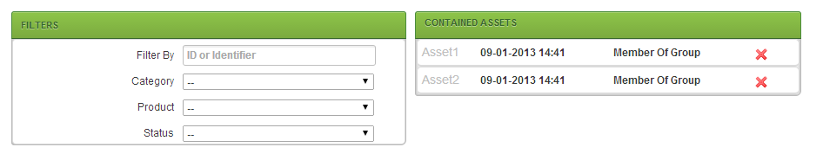
Create Assets – Assets
Asset Groups
We can define groups of assets where you only add one item to the order but that means you get a bunch of assets as a result.

Slide 19
Agenda
Asset Management Basics
Create Assets
Product Category
Allow Asset Management
Identifier Label
Asset Statuses
Asset Meta Fields
Product
Asset
Asset Groups
Transitions
Upload Assets
Add Assets to Orders
Create Assets on the Fly

Slide 20
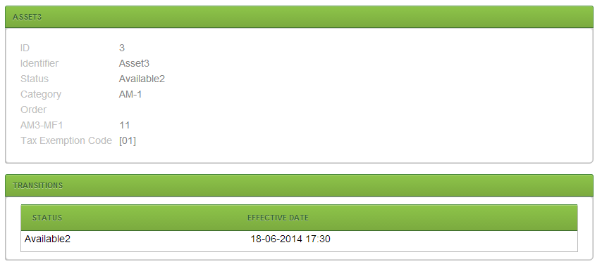
Create Assets – Assets
Transitions
Transitions are created when something happens to an asset.
Plug-in type IInternalEventTask -> AssetUpdatedTask.
Show Example

Slide 21
Agenda
Asset Management Basics
Create Assets
Product Category
Allow Asset Management
Identifier Label
Asset Statuses
Asset Meta Fields
Product
Asset
Asset Groups
Transitions
Upload Assets
Add Assets to Orders
Create Assets on the Fly

Slide 22
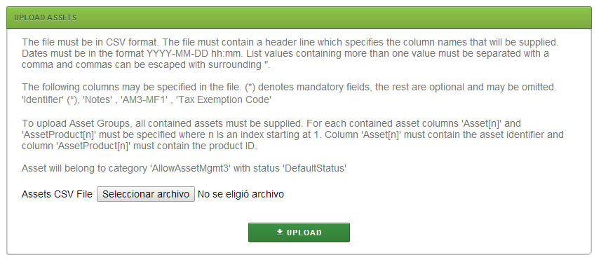
Upload Assets
We can upload assets in large numbers by uploading a csv file.
Spring Batch is used to do this.
Show Example

Slide 23
Agenda
Asset Management Basics
Create Assets
Product Category
Allow Asset Management
Identifier Label
Asset Statuses
Asset Meta Fields
Product
Asset
Asset Groups
Transitions
Upload Assets
Add Assets to Orders
Create Assets on the Fly

Slide 24
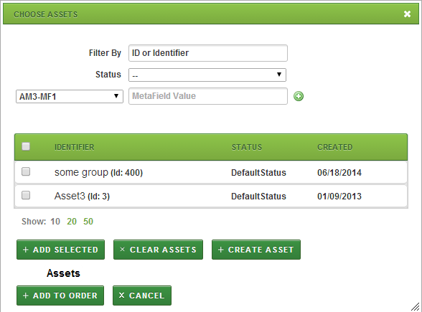
Add Assets to Orders
During the Order Creation Flow if we select a product that has assets we need to define the specific asset or assets that we want to select.
Only AVAILABLE assets can be added.
Status is changed to ORDERED so it stops being available.
We can create assets on the fly.
Show Example

Slide 26
!Thank you!

